Slide 1
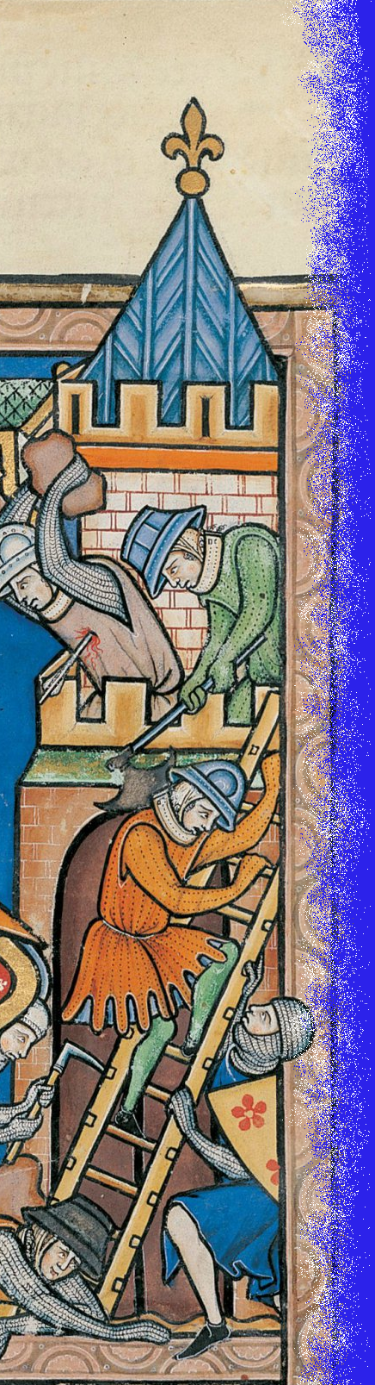
The Battle of Chesterfield
15th May 1266

Slide 2

Peter Gray
Notes:
Part of 750th Anniversary events

Slide 3
Background and account of the battle
Notes:
!3th C background to the battle and an account of the day.
Update on plans for 15th May 2016

Slide 4
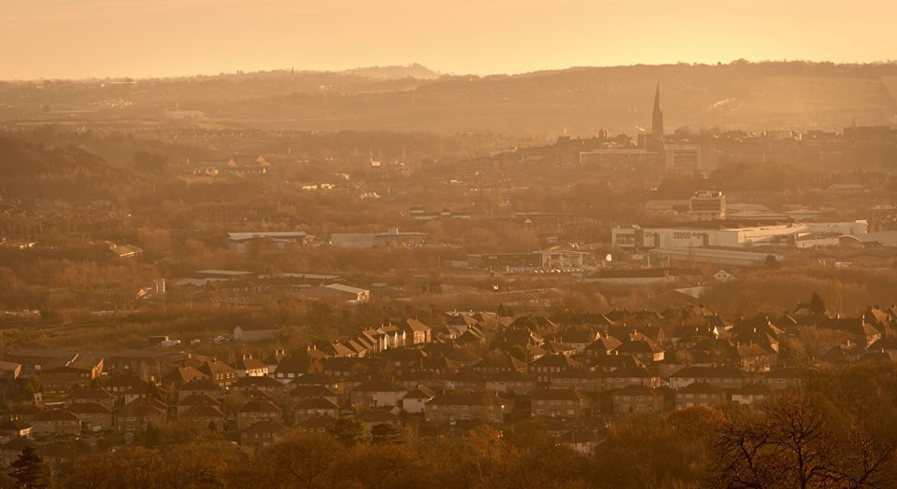

Slide 5
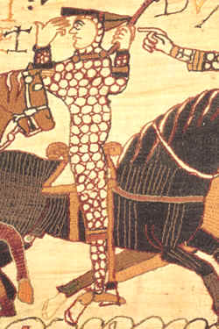
William I 1066 - 1087

Slide 6
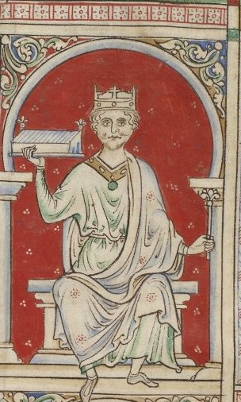
William II 1087 - 1100

Slide 7
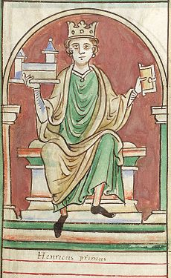
Henry I 1100 - 1135

Slide 8
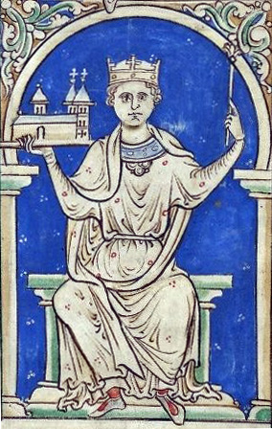
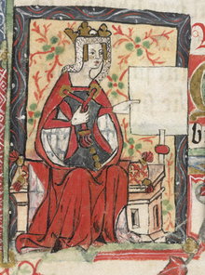
Stephen
1135 - 1154
Empress Matilda

Slide 9
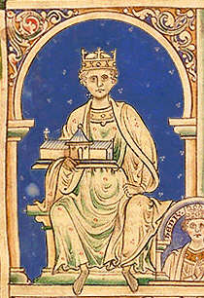
Henry II 1154 - 1189

Slide 10
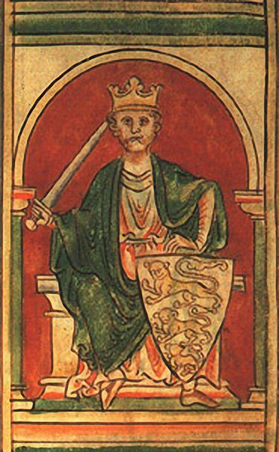
Richard I 1189 - 1199

Slide 11
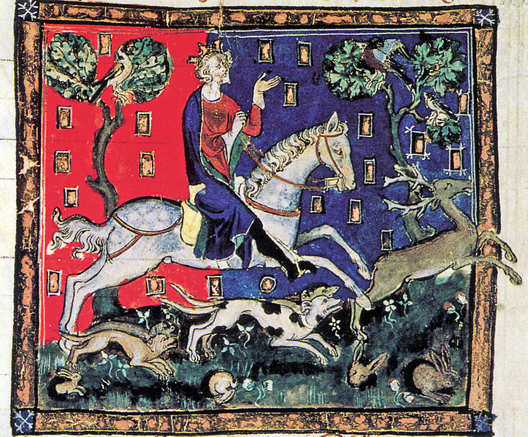
John 1199 - 1216

Slide 12
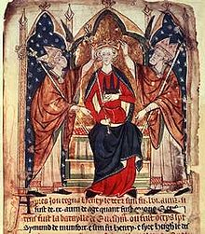
Henry III 1216 - 1272

Slide 13
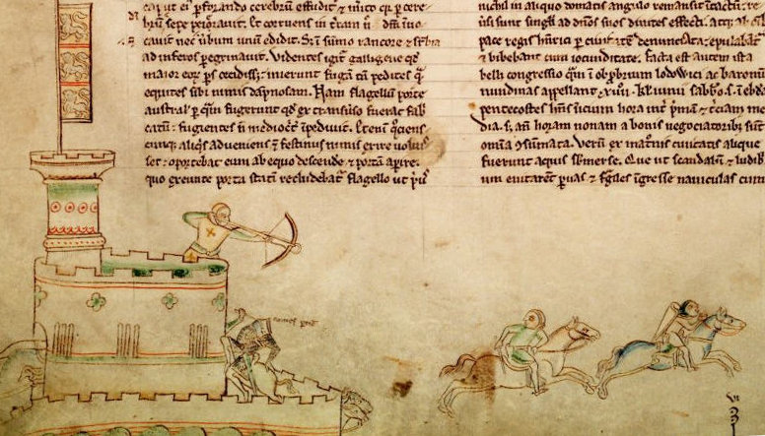
The Battle of Lincoln in May 1217
from Matthew Paris’ Chronica Majora

Slide 14
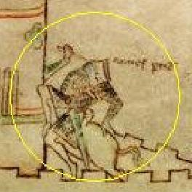


Slide 15
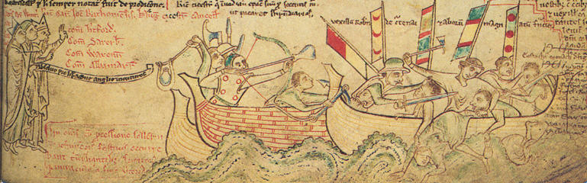
The Battle of Sandwich
in August 1217
from Matthew Paris’ Chronica Majora

Slide 16
Henry III 1216 - 1272

Slide 17
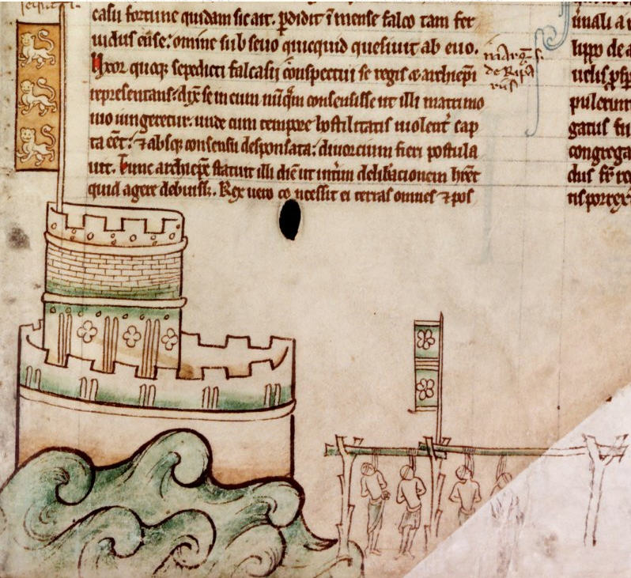
Bedford Castle August 1224
from Matthew Paris’ Chronica Majora

Slide 18
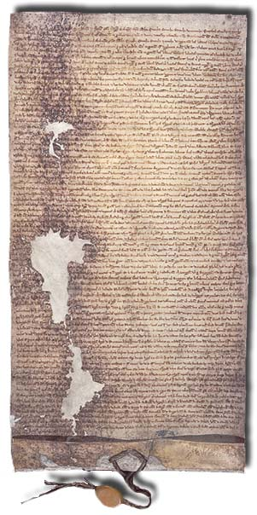
The Great Charter
of 1225
also known as the
Magna Carta
National Archives

Slide 19
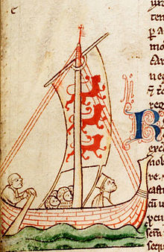
Henry III crossing to France August 1230
from Matthew Paris’ Chronica Majora

Slide 20
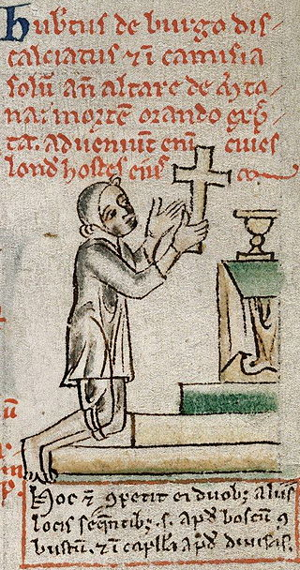
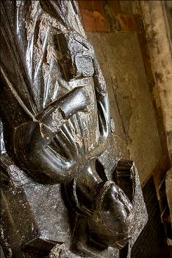
Hubert de Burgh
Peter des Roches

Slide 21
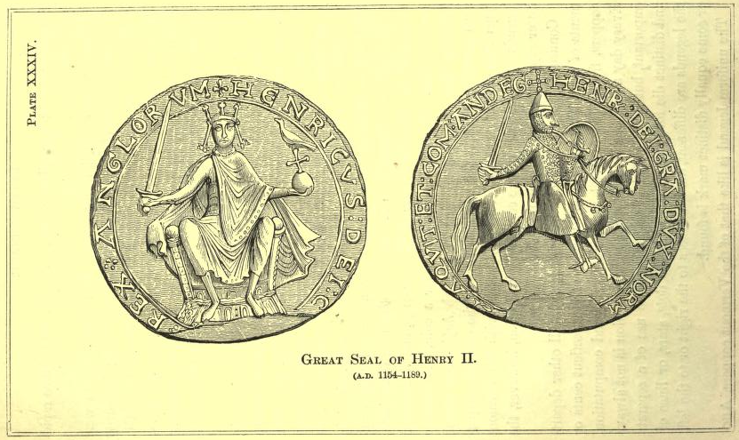
Henry’s Great Seal

Slide 22
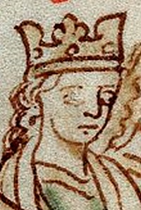
Eleanor of Provence
from
Matthew Paris

Slide 23
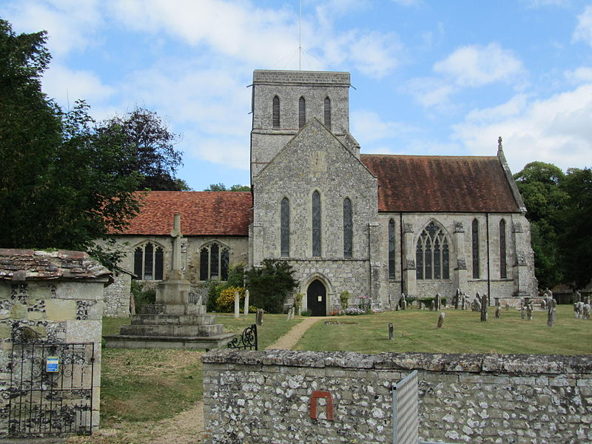
Church of St Mary
and St Melor, Amesbury

Slide 24
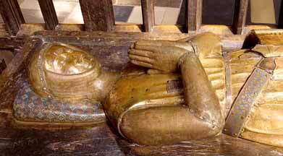
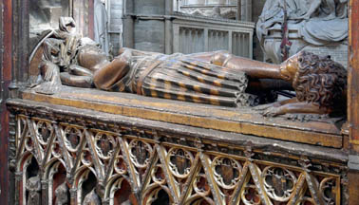
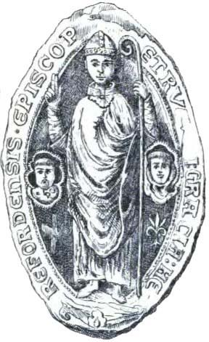
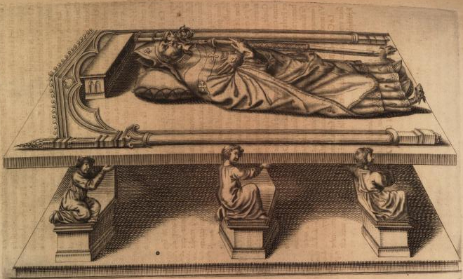
Guillaume de Lusignan
Aymer
de
Valence
Peter of
Aigueblance
Bonniface of Savoy

Slide 25
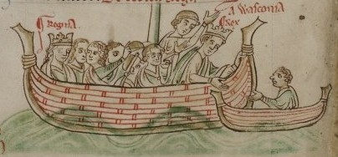
Henry and Eleanor returning from France in 1243
from Matthew Paris

Slide 26
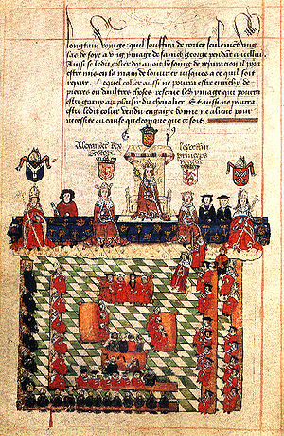
The Provisions of Oxford
1258

Slide 27

Simon de Montfort

Slide 28
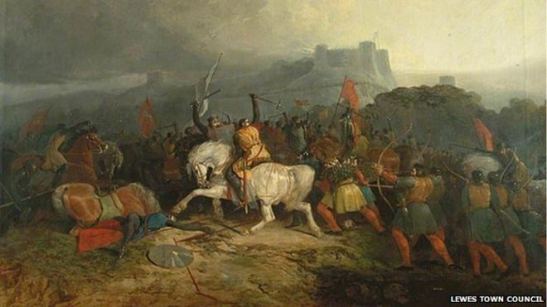
The Battle of Lewes
Painting by Hardy, early 1900

Slide 29
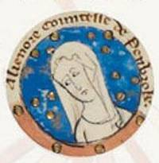
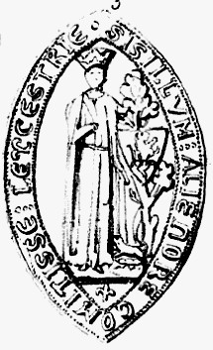
Eleanor de Montfort
married Simon, 1238
Eleanor’s seal as Countess of Leicester

Slide 30
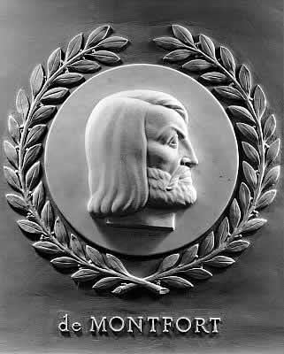
Simon de Montfort
1950’s relief in the United States’ House of Representatives

Slide 31
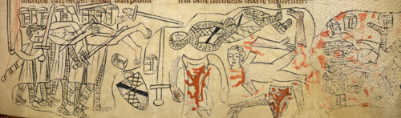
Death of Simon de Montfort at Evesham in August 1265
British Library Cotton MS Nero D ii, f. 177

Slide 32
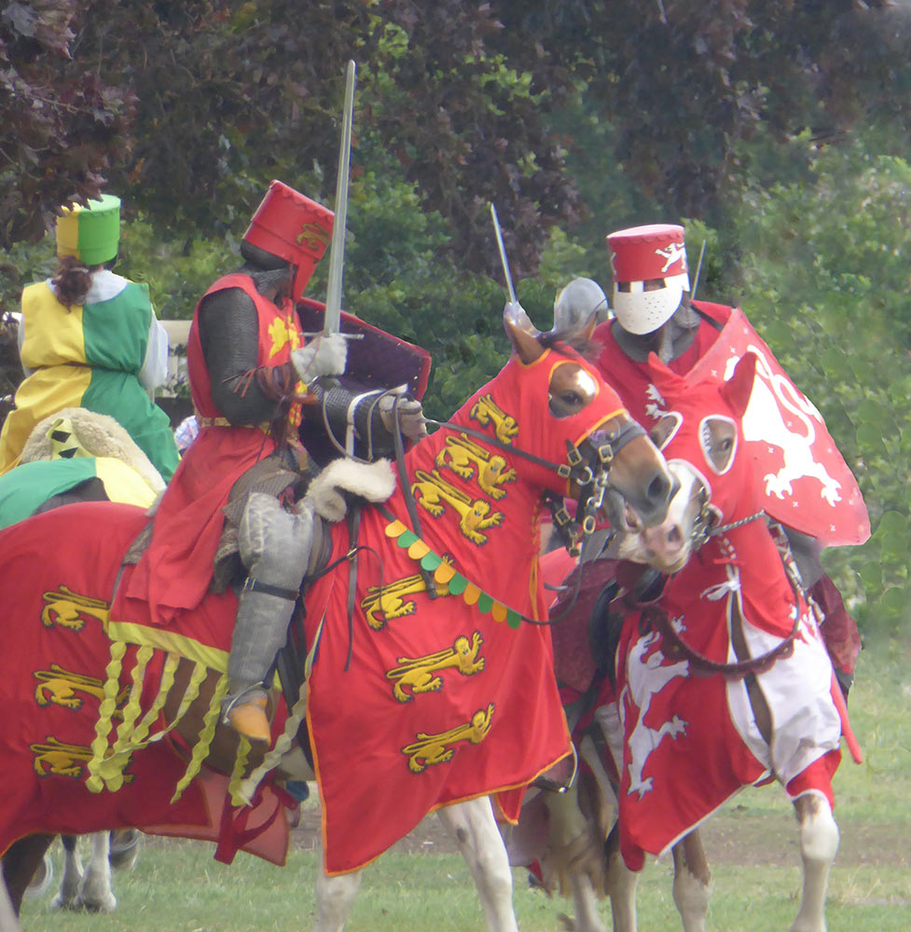
Re-enactment at Evesham in August last year

Slide 33
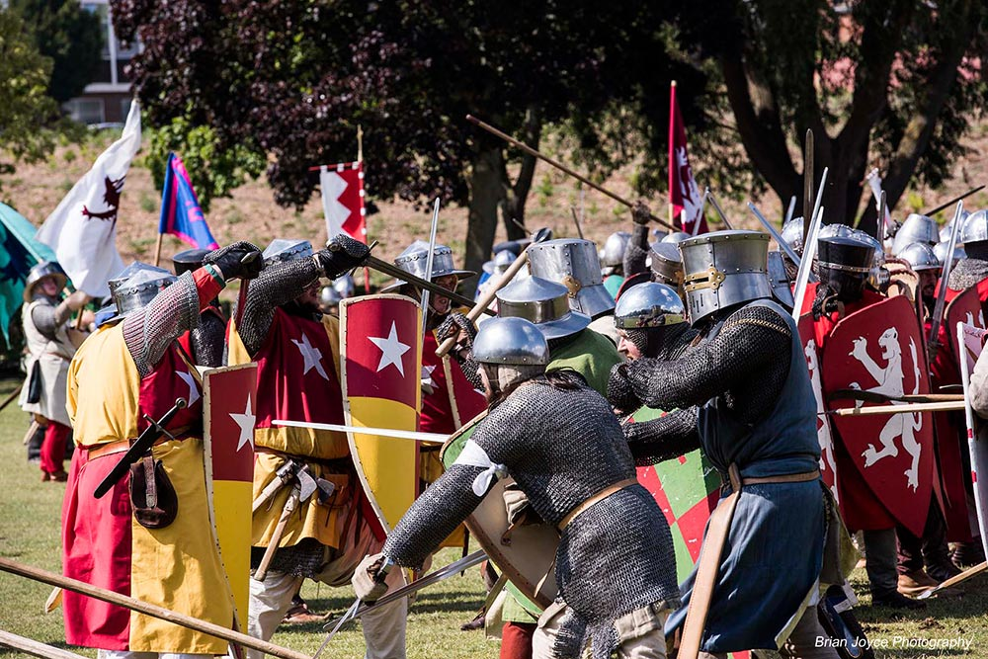

Slide 34
Aftermath of Evesham

Slide 35
Henry III 1216 - 1272

Slide 36


Slide 37
Henry III 1216 - 1272

Slide 38
Duffield Castle then…
Artist’s
Impression
– National Trust/PigHill
National Trust image not in the public domain

Slide 39
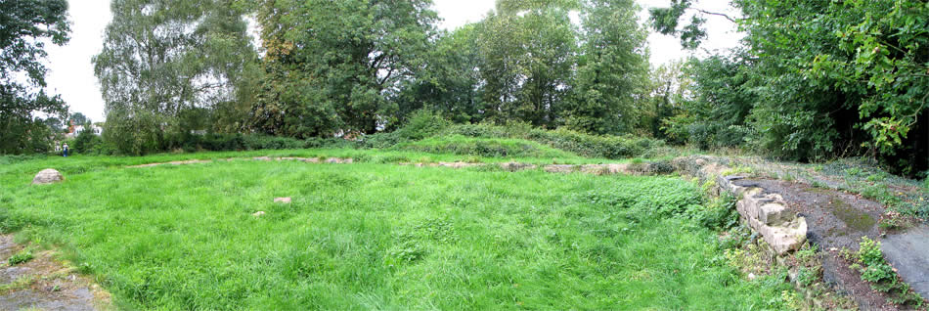
… and now
www.castleuk.net

Slide 40

Robert de Ferrers -
the Earl of Derby

Slide 41

Baldwin Wake

Slide 42

John D’Ayville

Slide 43
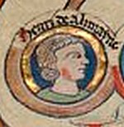
Henry of Almain
from the British Library

Slide 44

Henry of Almain
Royal Coat of Arms

Slide 45
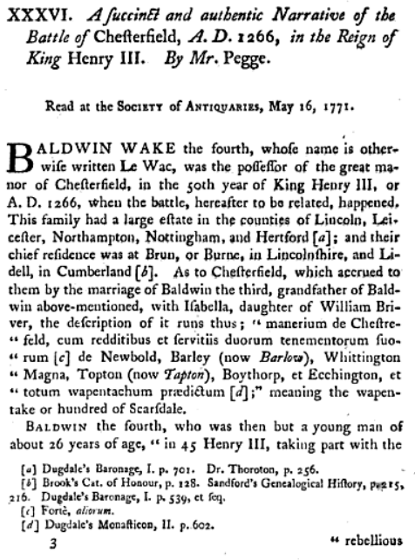
Page 1
of
Pegge’s
account

Slide 46
Henry of Almain
Sheffield
D’Ayville
Castleton
Wake
Chesterfield
Where was Henry of Almain and the Royalist Force?
Duffield
Nottingham
De Ferrers
Derby

Slide 48
Robert de Ferrers -
the sixth, and last, Earl of Derby

Slide 49
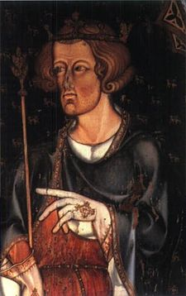
Henry of Almain
Prince Edward – ruled as Edward I 1272 - 1307

Slide 50
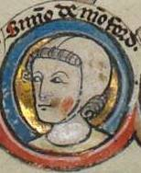
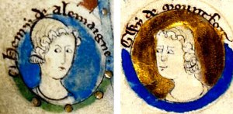
Simon
de Montfort,
the younger
Guy
de Montfort

Slide 51
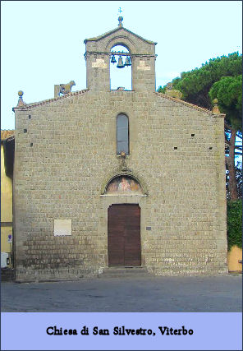

Slide 52


Slide 53
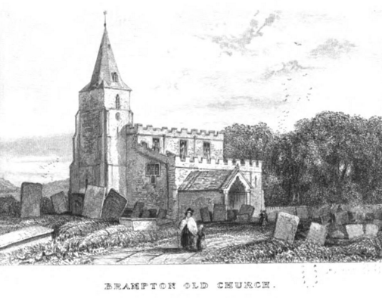

Slide 54
Solebant etiam (Bramptonienses) facere partem suam murorum coemeterii (de Chesterfield), et tempora guerrae Domini Simonis de Monteforte, se recipiebant sub parte illa quam faciebant, nolentes alios permittere ibidem recipi
[the inhabitants of Brampton] were accustomed also to make their part of the walls of the burial-ground (of Chesterfield), and in the time of the war of Lord Simon de Montfort they betook themselves to that part of the wall which they built, being unwilling to allow others to be admitted there.

